Slide 1

H biter
An Passport to Good Habits!

Slide 2
THE ONE
Introduction & Motivation

Slide 3
Habiter
“A WeChat Miniprogram to help users to develop good habits, and have a regular and healthy lifestyle in fragment spare time.”

Slide 4
Existed Problems
Discrete and Redundant Functions
Bad UI &
No Interaction
Personal Information
Leak
3 Existed Problems in Common Software

Slide 5
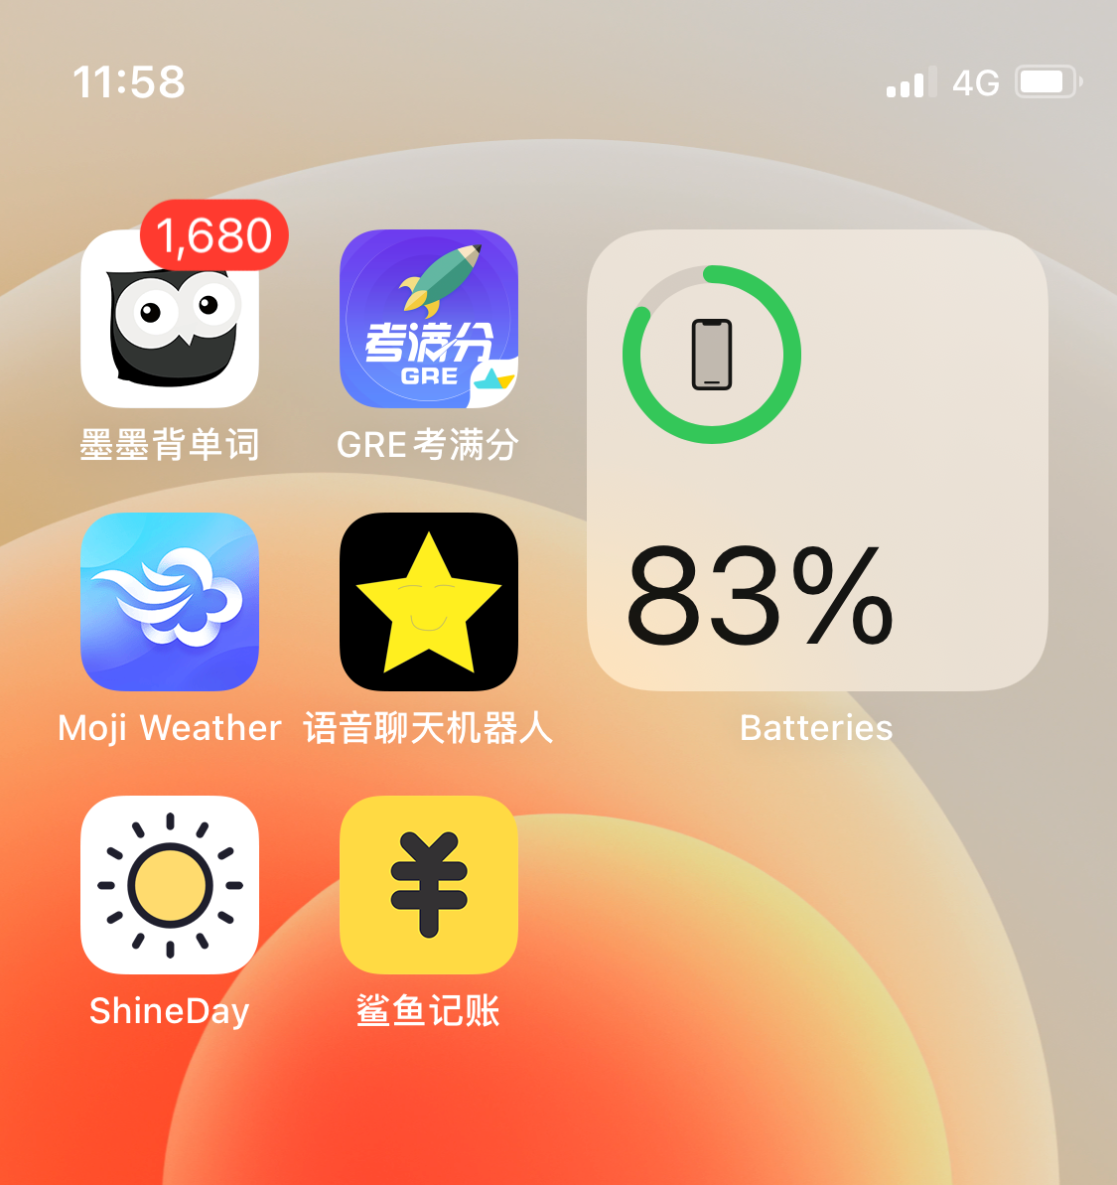
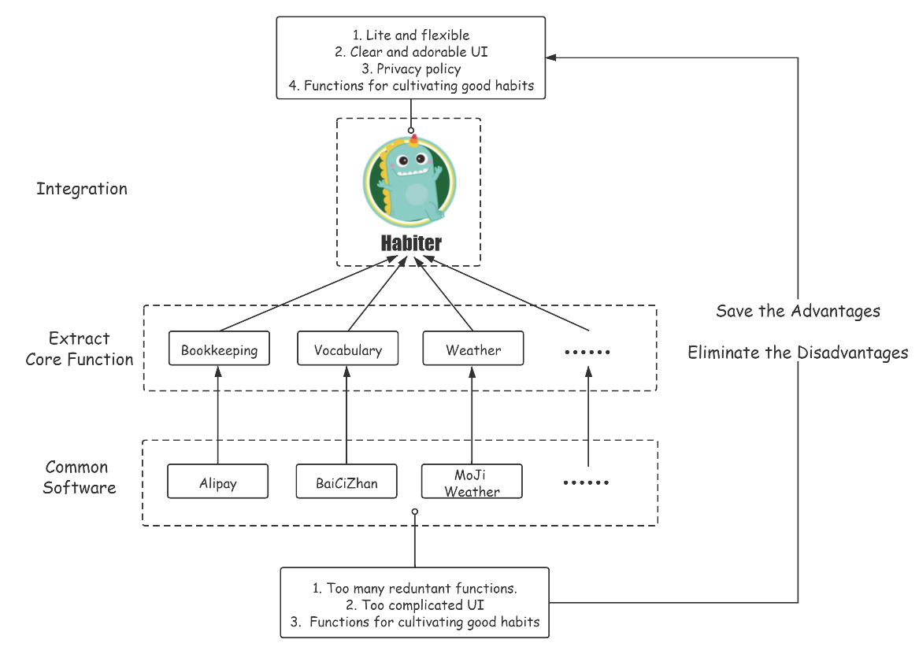
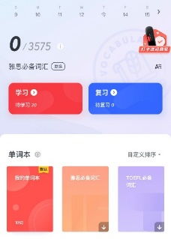
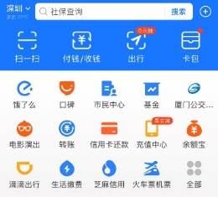
Light-Weighted & Integrated

Slide 6
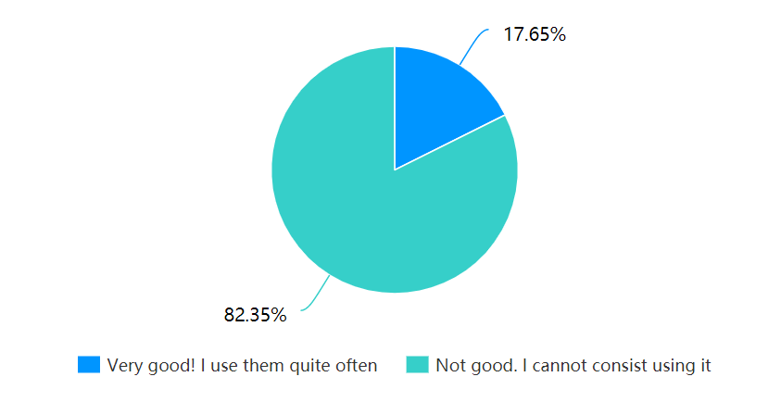
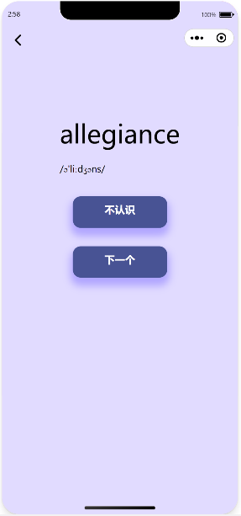
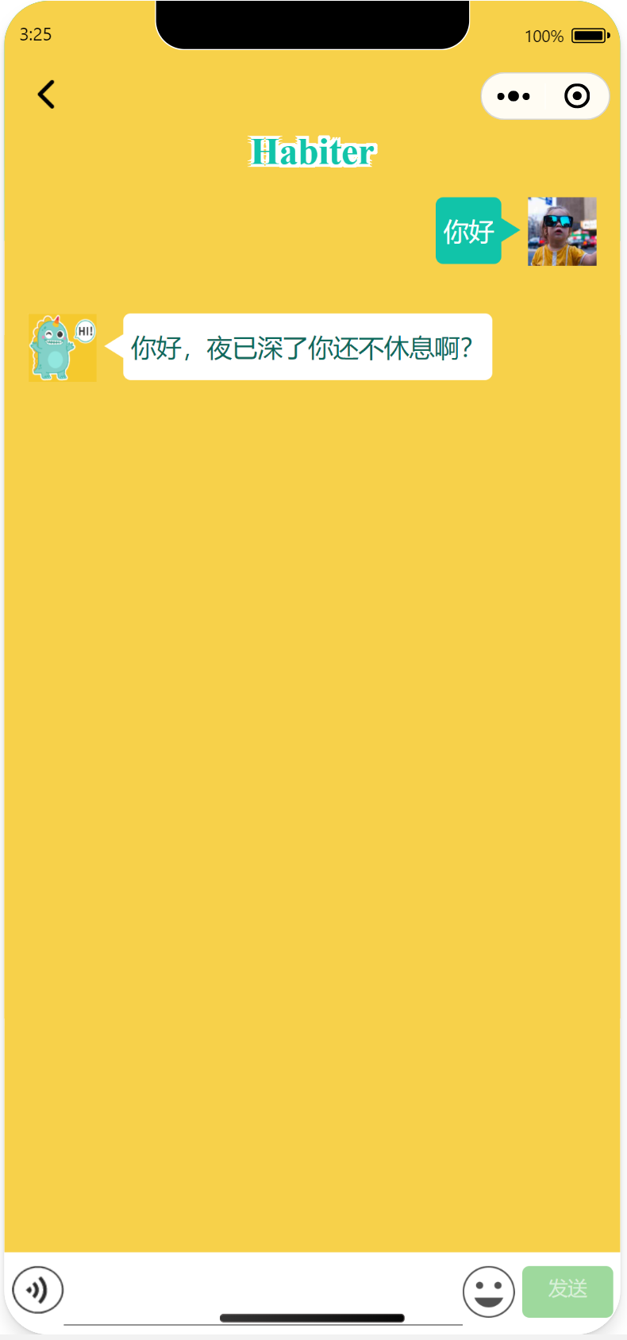
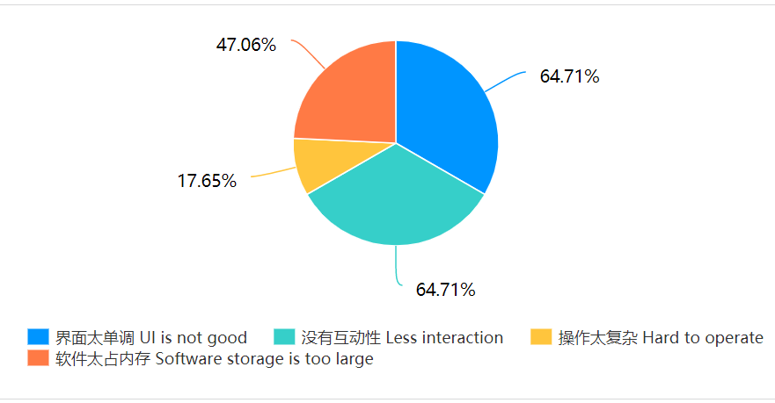
Friendly UI & Interaction

Slide 7
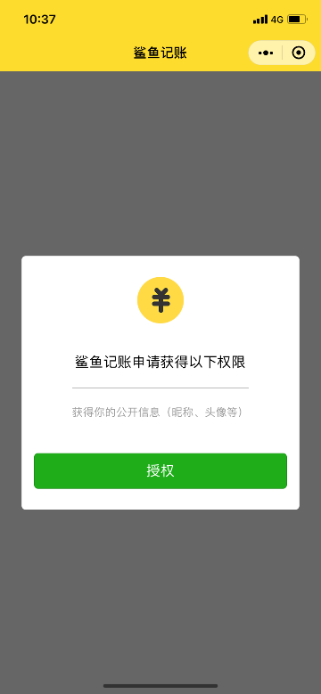
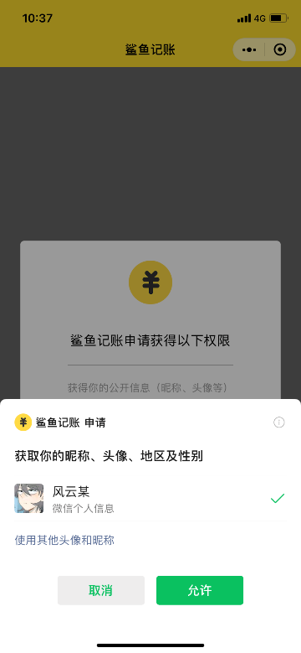
Privacy Protection
Each user will be attributed a random and private ID to access data to the system.

Slide 8
THE TWO
Software Architecture

Slide 9
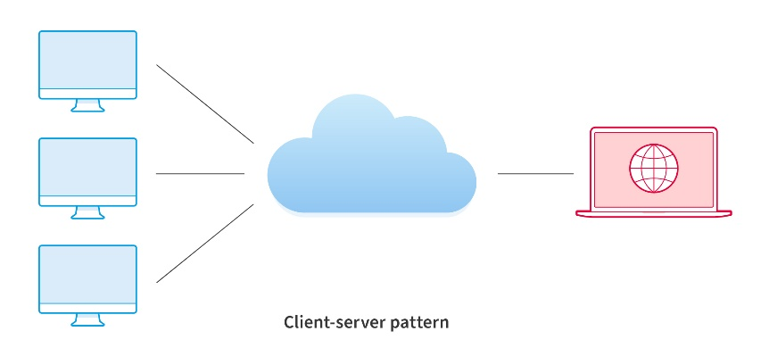
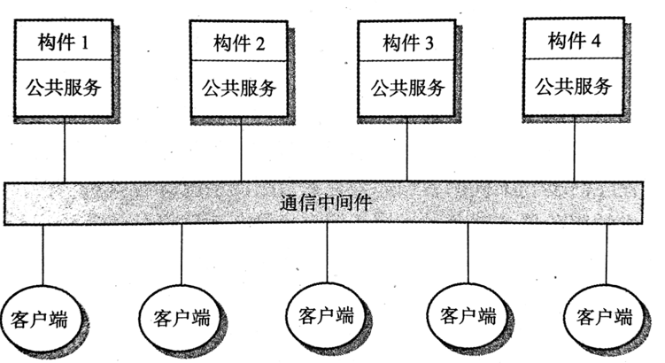
Architecture - Pattern
Client-Server Architecture
Distributed Components Architecture

Slide 10
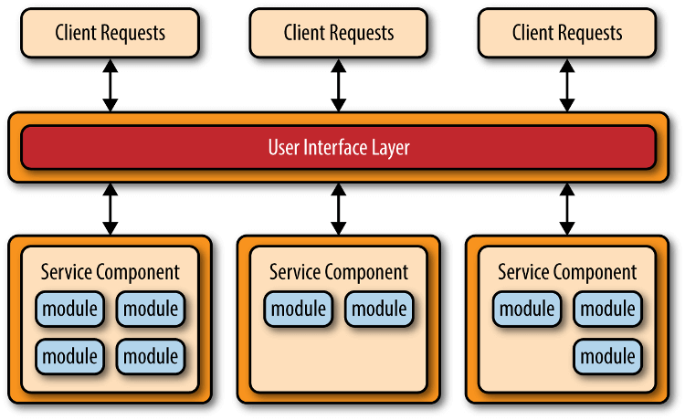
Architecture - Pattern
Microservice Architecture

Slide 11
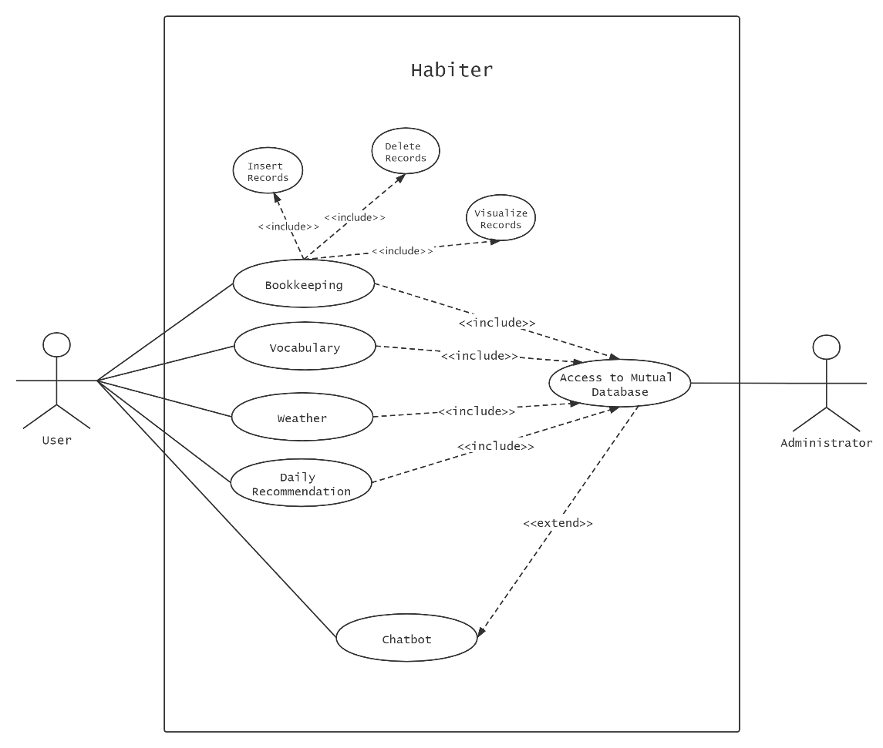
Architecture - UML

Slide 12
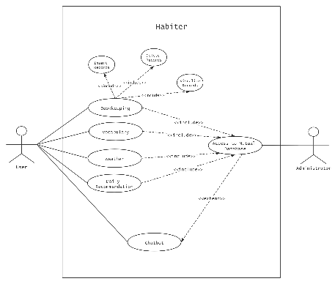
Architecture - UML

Slide 13
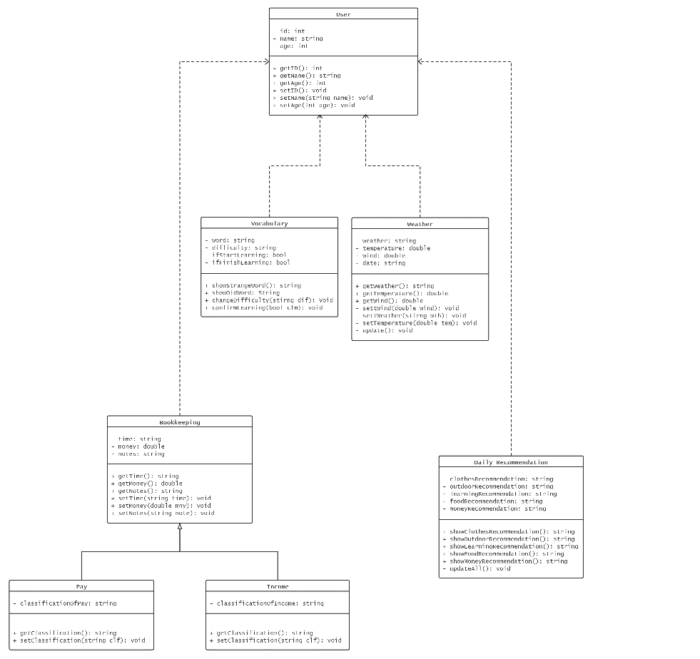
Architecture - UML

Slide 14
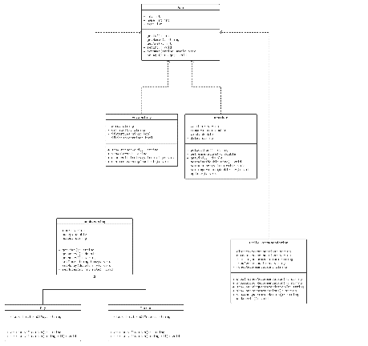
Architecture - UML

Slide 15
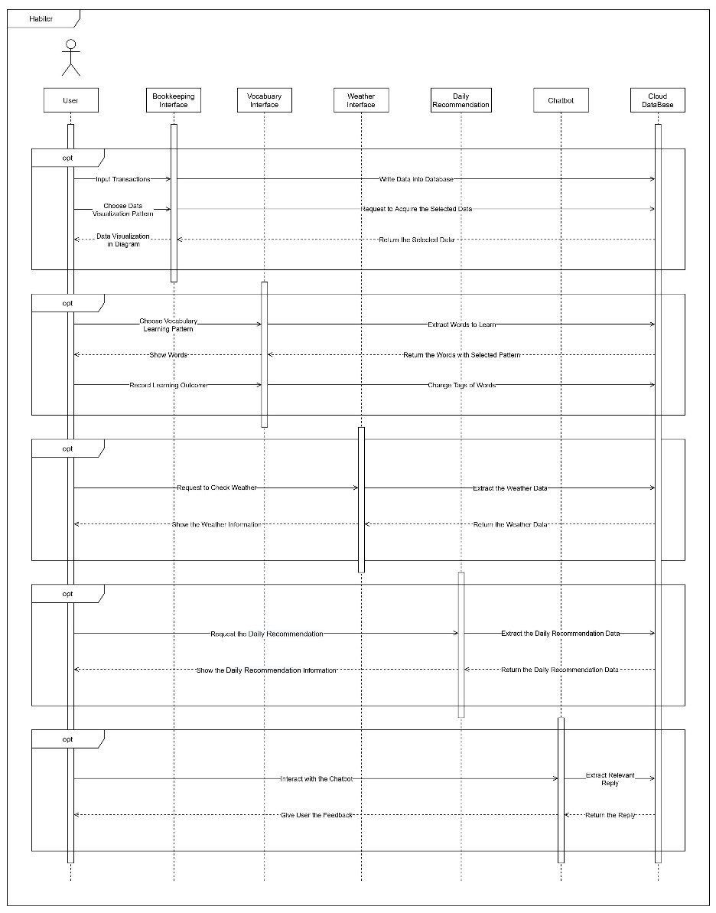
Architecture - UML

Slide 16
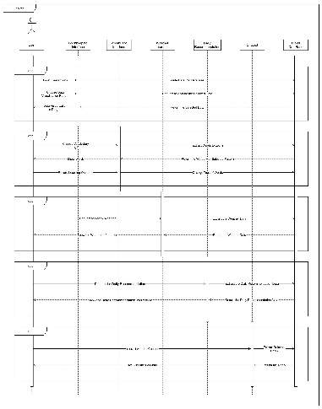
Architecture - UML

Slide 17
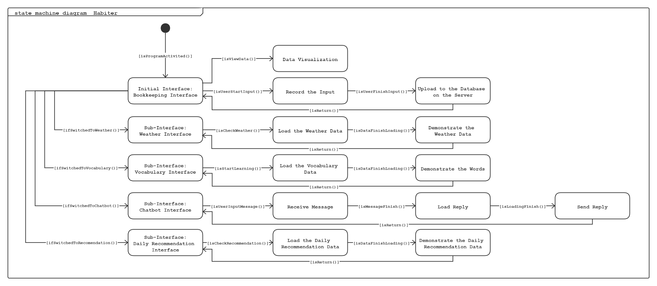
Architecture - UML

Slide 18
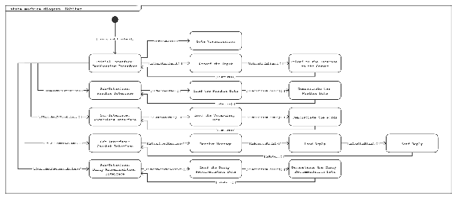
Architecture - UML

Slide 19
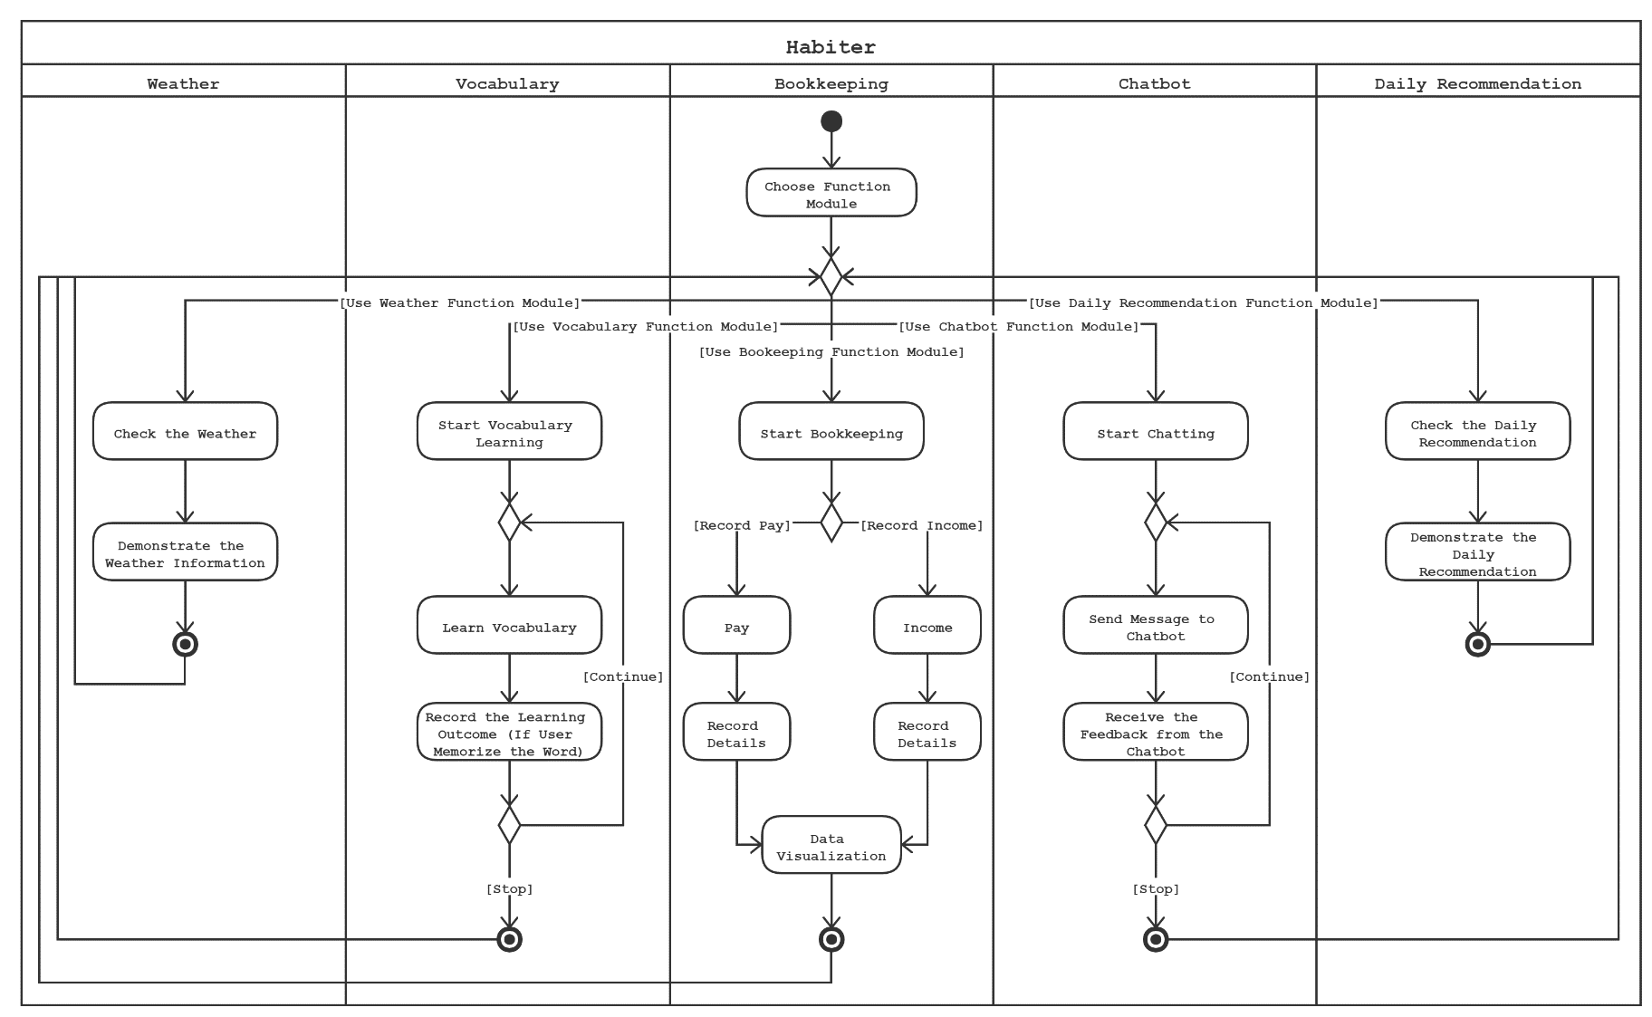
Architecture - UML

Slide 20
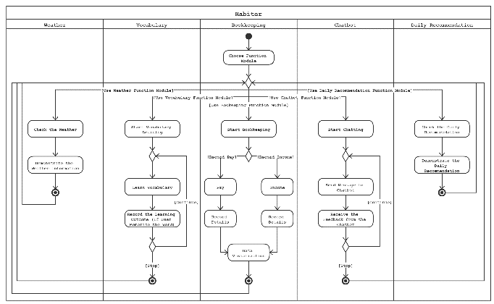
Architecture - UML

Slide 21
THE THREE
Implementation & Development

Slide 22

















Client-server & cloud & micro architecture
Implementation （讲解微信小程序，介绍云开发，相当于进一步解释前一部分的architecture pattern具体是由什么组成的）
APIs (一些重要组件是如何接入的，可以配合一点代码)
Implementation
Each page is a component,
Which corresponds to a micro-function/micro-service, which is consists of the four file types. The pages are downloaded in the client side.
Cuz our core is habit (details of daily life)
Targeted on each individual
Need strong scalability & loose coupling
.wxss
Cloud Environment
Data Visualization
Cloud Function
.wxml
Chatbot
Resource Monitor
Scalable resources
Pay as you go
Bookkeeper
Cloud Database
Scalability tradeoff a bit overhead
File Storage
Cloud Base
.json
Vocabulary
Weather & Cloth
.js
implementation
代码？
报告 – 多截几张图

Slide 23
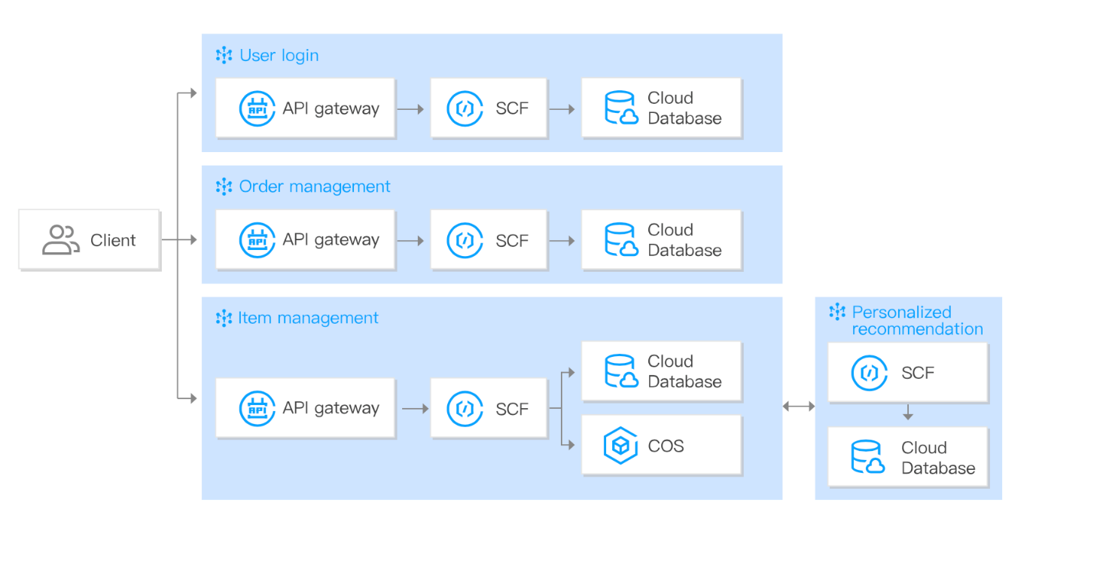








Cloud Base
Cross-Platforms
Clientwise Separated
Accessibility
Reliability
Easy to Scale
Easy to Maintain
Scalability
Cost Saving
Zero maintance, running in tecent infrustrucrture service
Serverless, no need to manage or scale the server (automaticly done)
Database, micro-function,
Frontend pages …

Slide 24
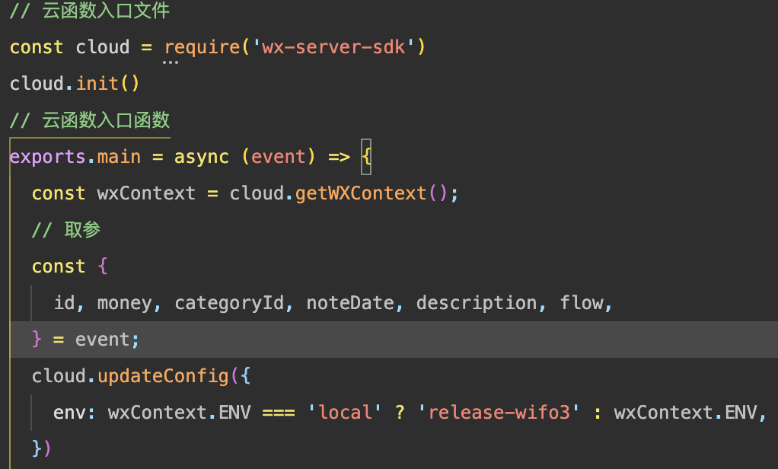
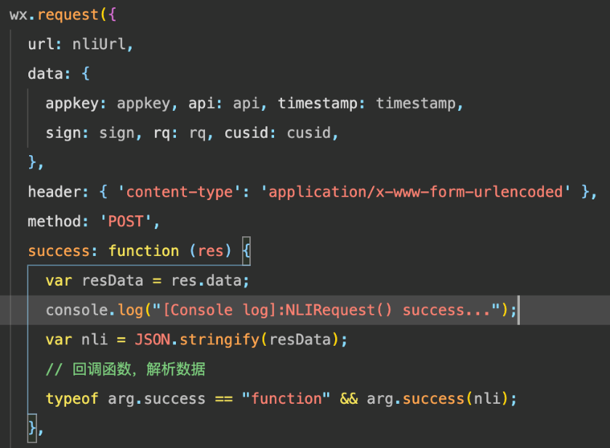
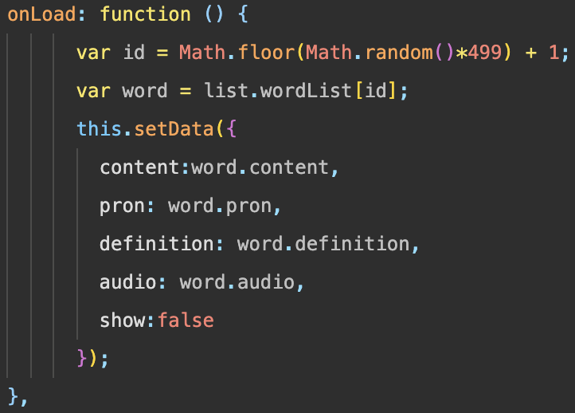
API
Bookkeeper
Chatbot
Vocabulary
Implemented with cloud service
Implemented by sending requests
Implemented entirely with local API

Slide 25
THE FOUR
Software Testing

Slide 26
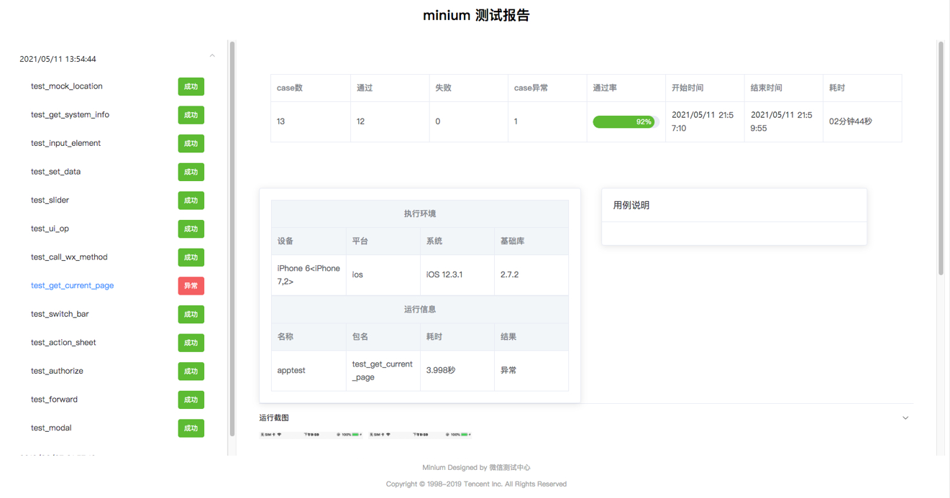
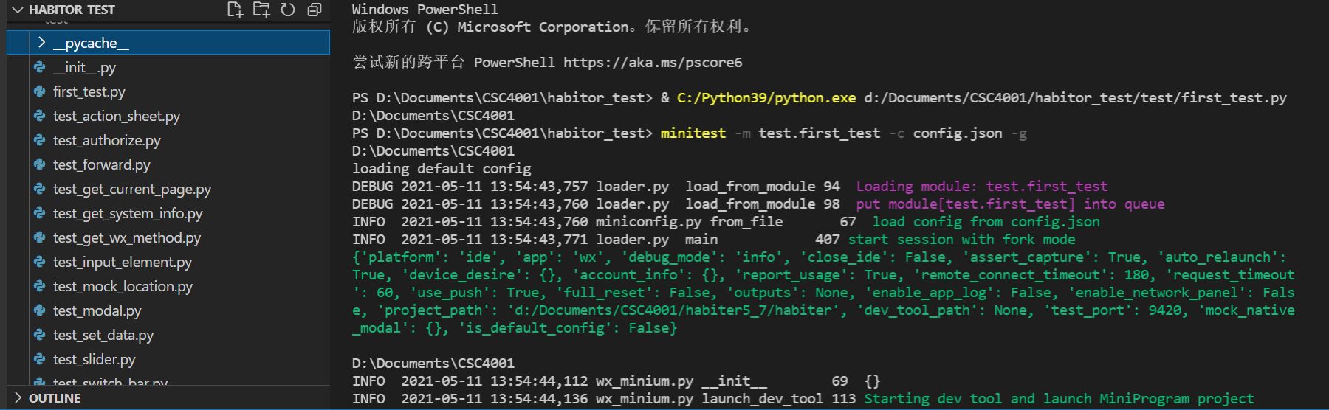

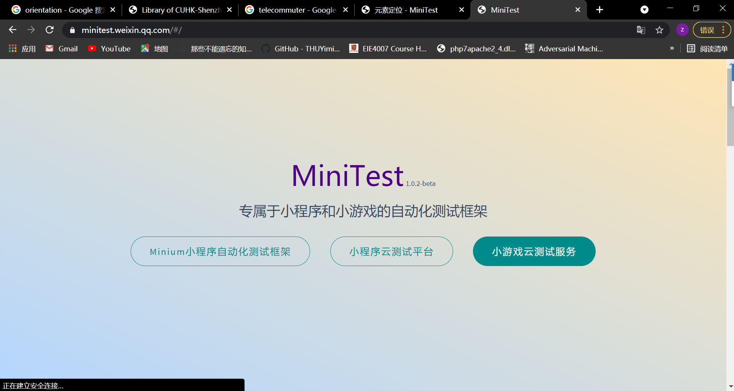
Testing Automation
Minium is an automation testing framework specially developed for WeChat Miniprogram, providing Python and JavaScript versions.
Minium can be used to automate the UI testing of Miniprograms, you can even use minium to mock functions, and to open some Miniprogram APIs.
Minitest
Minium

Slide 27
Basic Testing Structure
As for our basic testing structure, we used what we learned in lectures to test:
The functionality of objects or methods
The component interfaces
The component interactions
System Test
Component Test
Unit Test

Slide 28
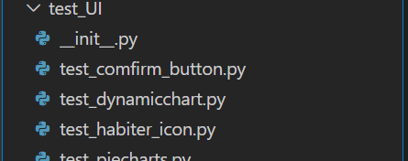
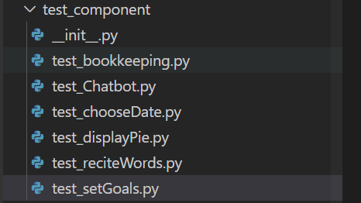
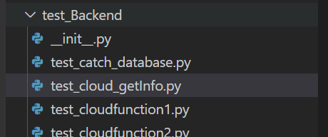
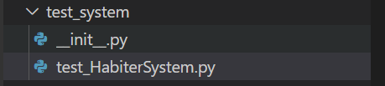
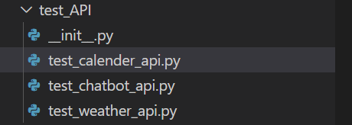
Basic Testing Examples
Test for Front End
Test for Back End
Test for API
Unit Test
Component Test
System Test

Slide 29
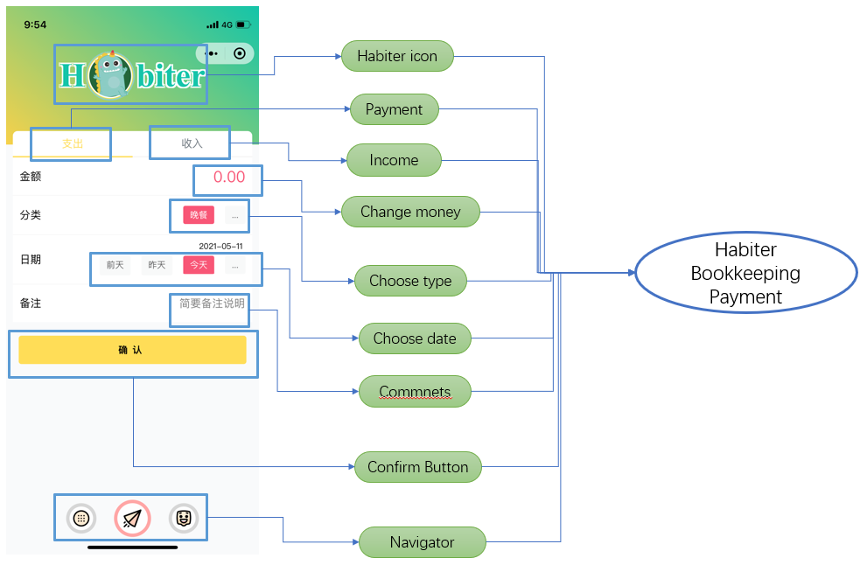
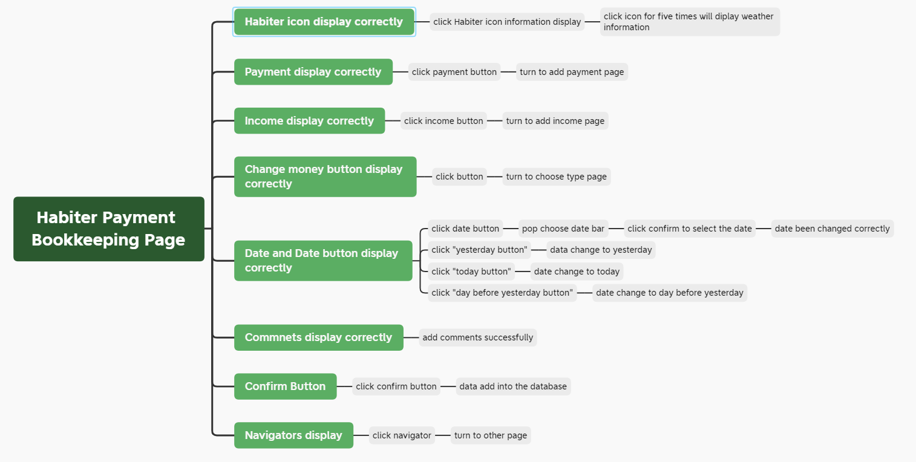
Release Testing
Black-box Test
For
Validation
Three People outside Our Group

Slide 30

Non-functional Analysis
Security
Compatibility
Maintainability
Portability
Broader Quality Attributes
based on Inspection

Slide 31
THE FIVE
Demonstration

Slide 32
Thank You!

